Slide 1
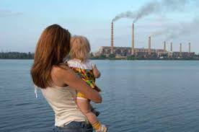
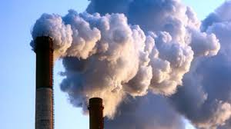

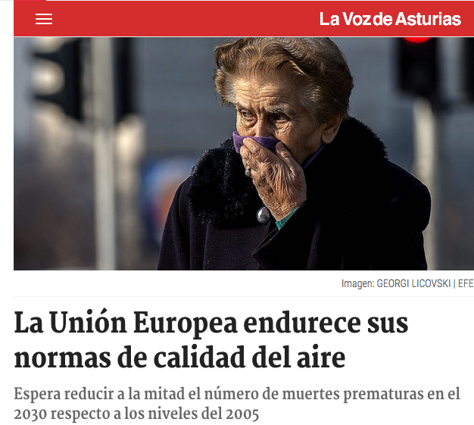
Fossil Fuels and Brain Health
Charles Gasparovic, The Mind Research Network,
La Plataforma Contra la Contaminación de Xixon, and 350.org
What are the major air pollutants and their sources?
What are the general health effects?
How does air pollution affect the young brain?
How does air pollution affect the adult brain?
What are the European Union regulations?

Slide 2
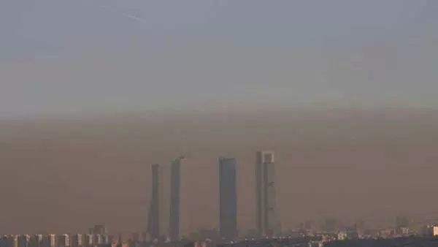
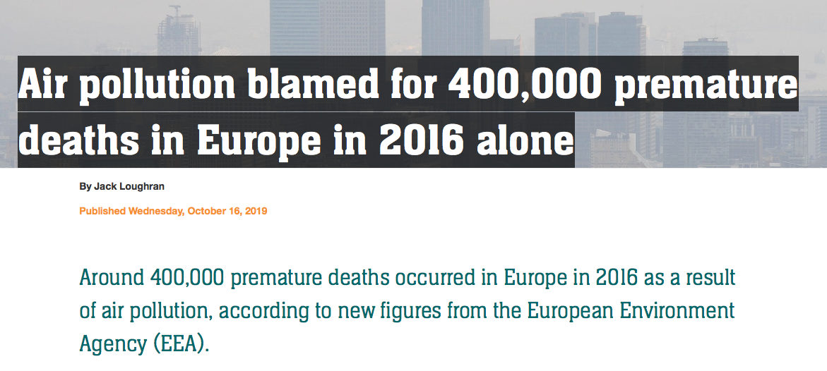
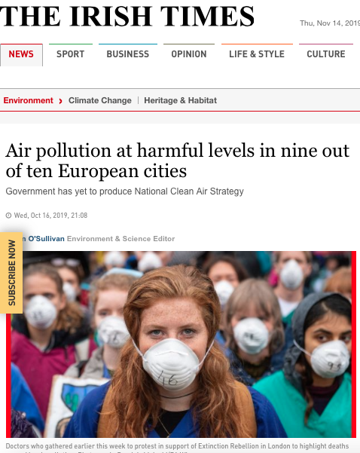
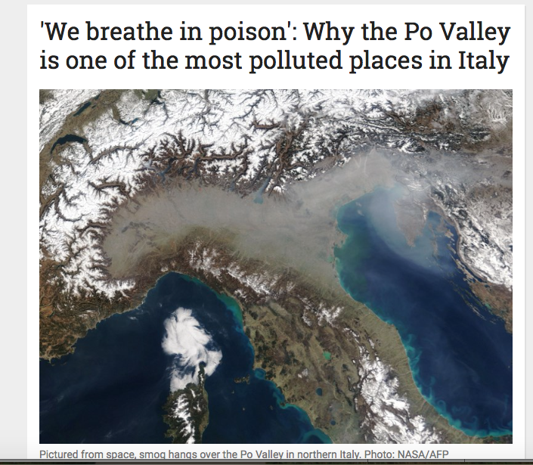
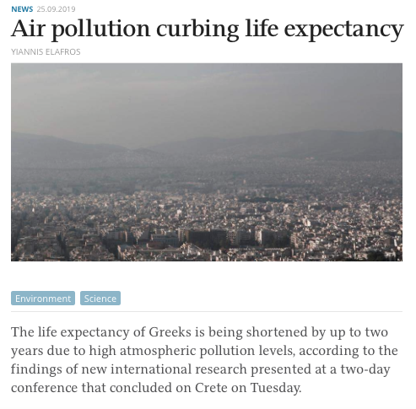
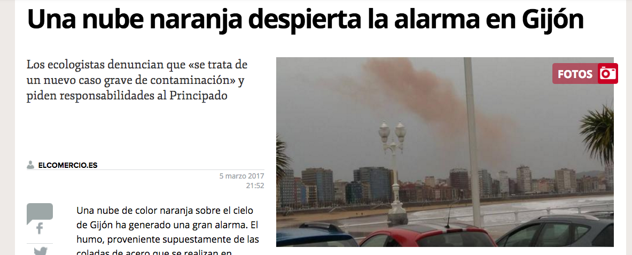
The “invisible killer”
The World Health Organization has concluded that Air Pollution is a cause of more than
7 million early deaths each year.

Slide 3
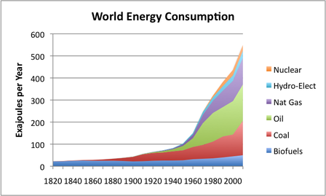


The “invisible killer”
The World Health Organization has concluded that Air Pollution is a cause of more than
7 million early deaths each year.
1.3 Billion
7.5 Billion
× 10
× 2.3
3.2 Billion
127 M
1963 Clean Air ACT
1963 Clean Air Act
2016
2016
https://ourfiniteworld.com/2012/03/12/world-energy-consumption-since-1820-in-charts/

Slide 4
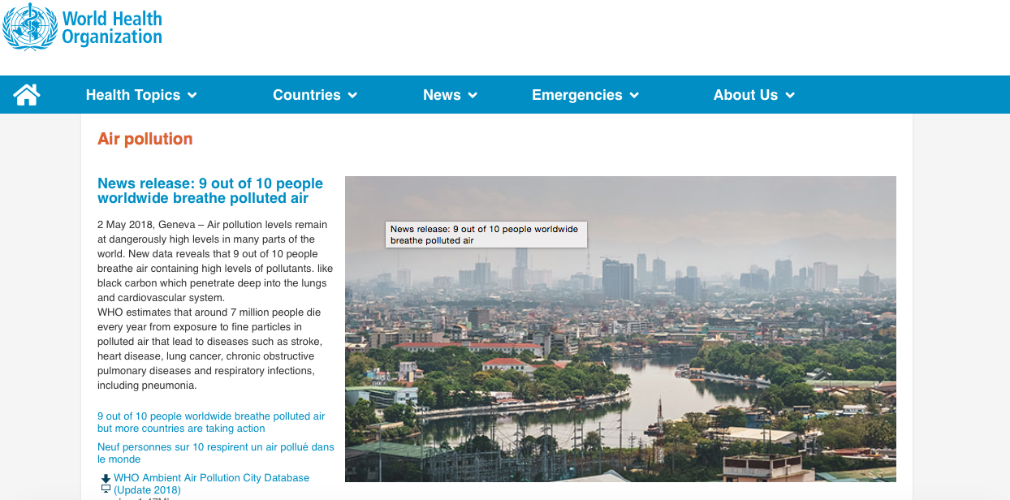
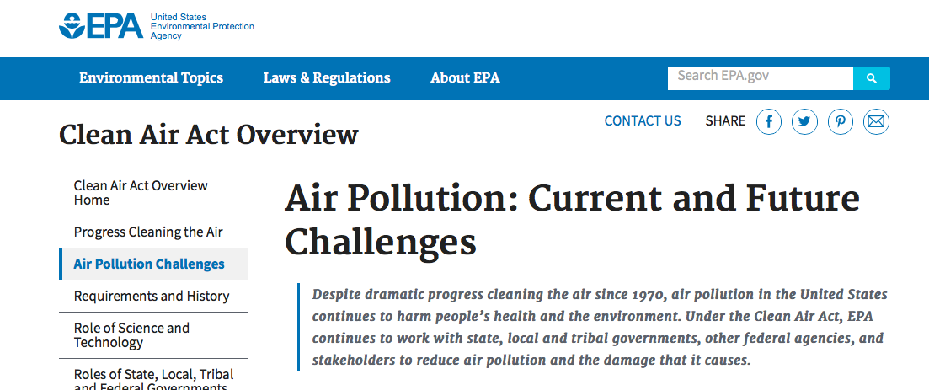
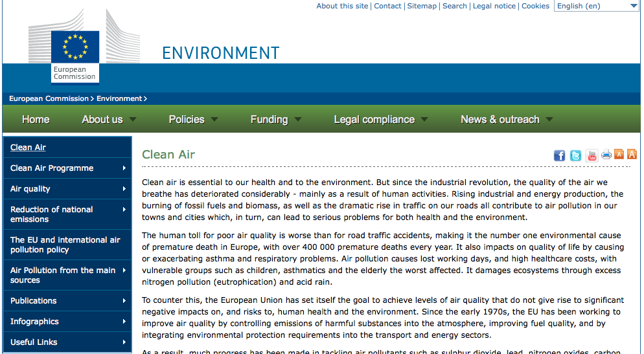
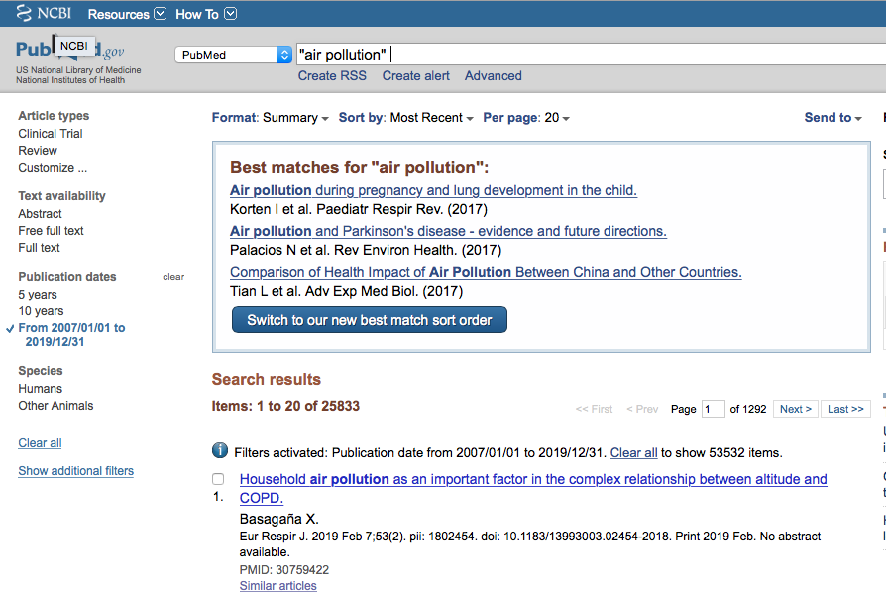
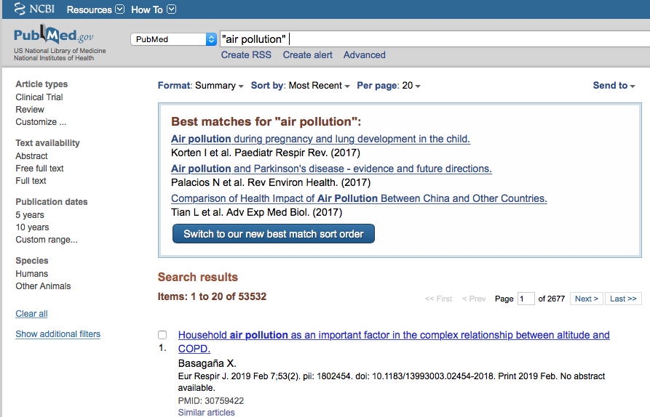
Sources

Slide 5
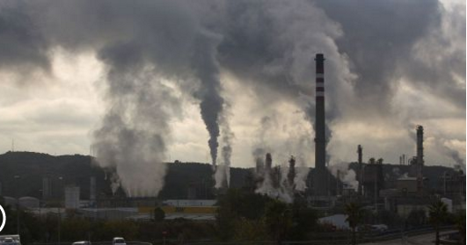
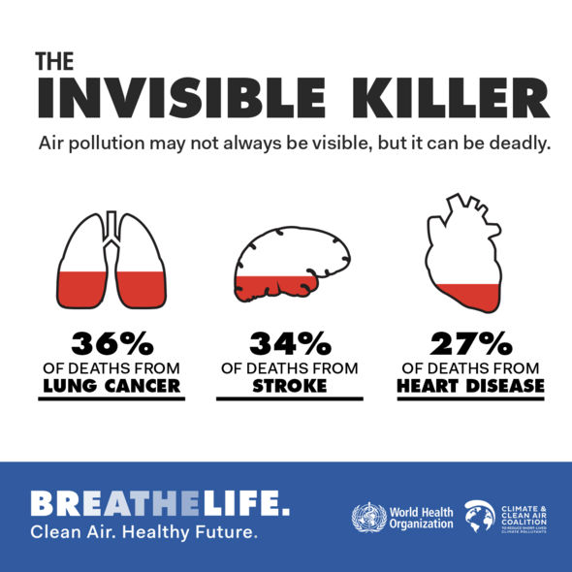
Worldwide ambient air pollution accounts for:
29% of all deaths and disease from lung cancer
17% of all deaths and disease from acute lower respiratory infection
24% of all deaths from stroke
25% of all deaths and disease from ischaemic heart disease
43% of all deaths and disease from chronic obstructive pulmonary disease
http://www.who.int/sustainable-development/news-events/breath-life/en/

Slide 6
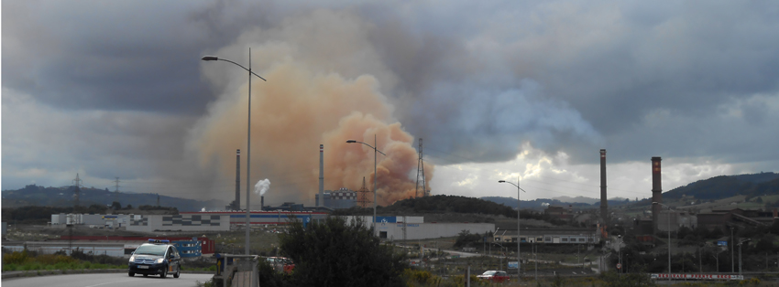
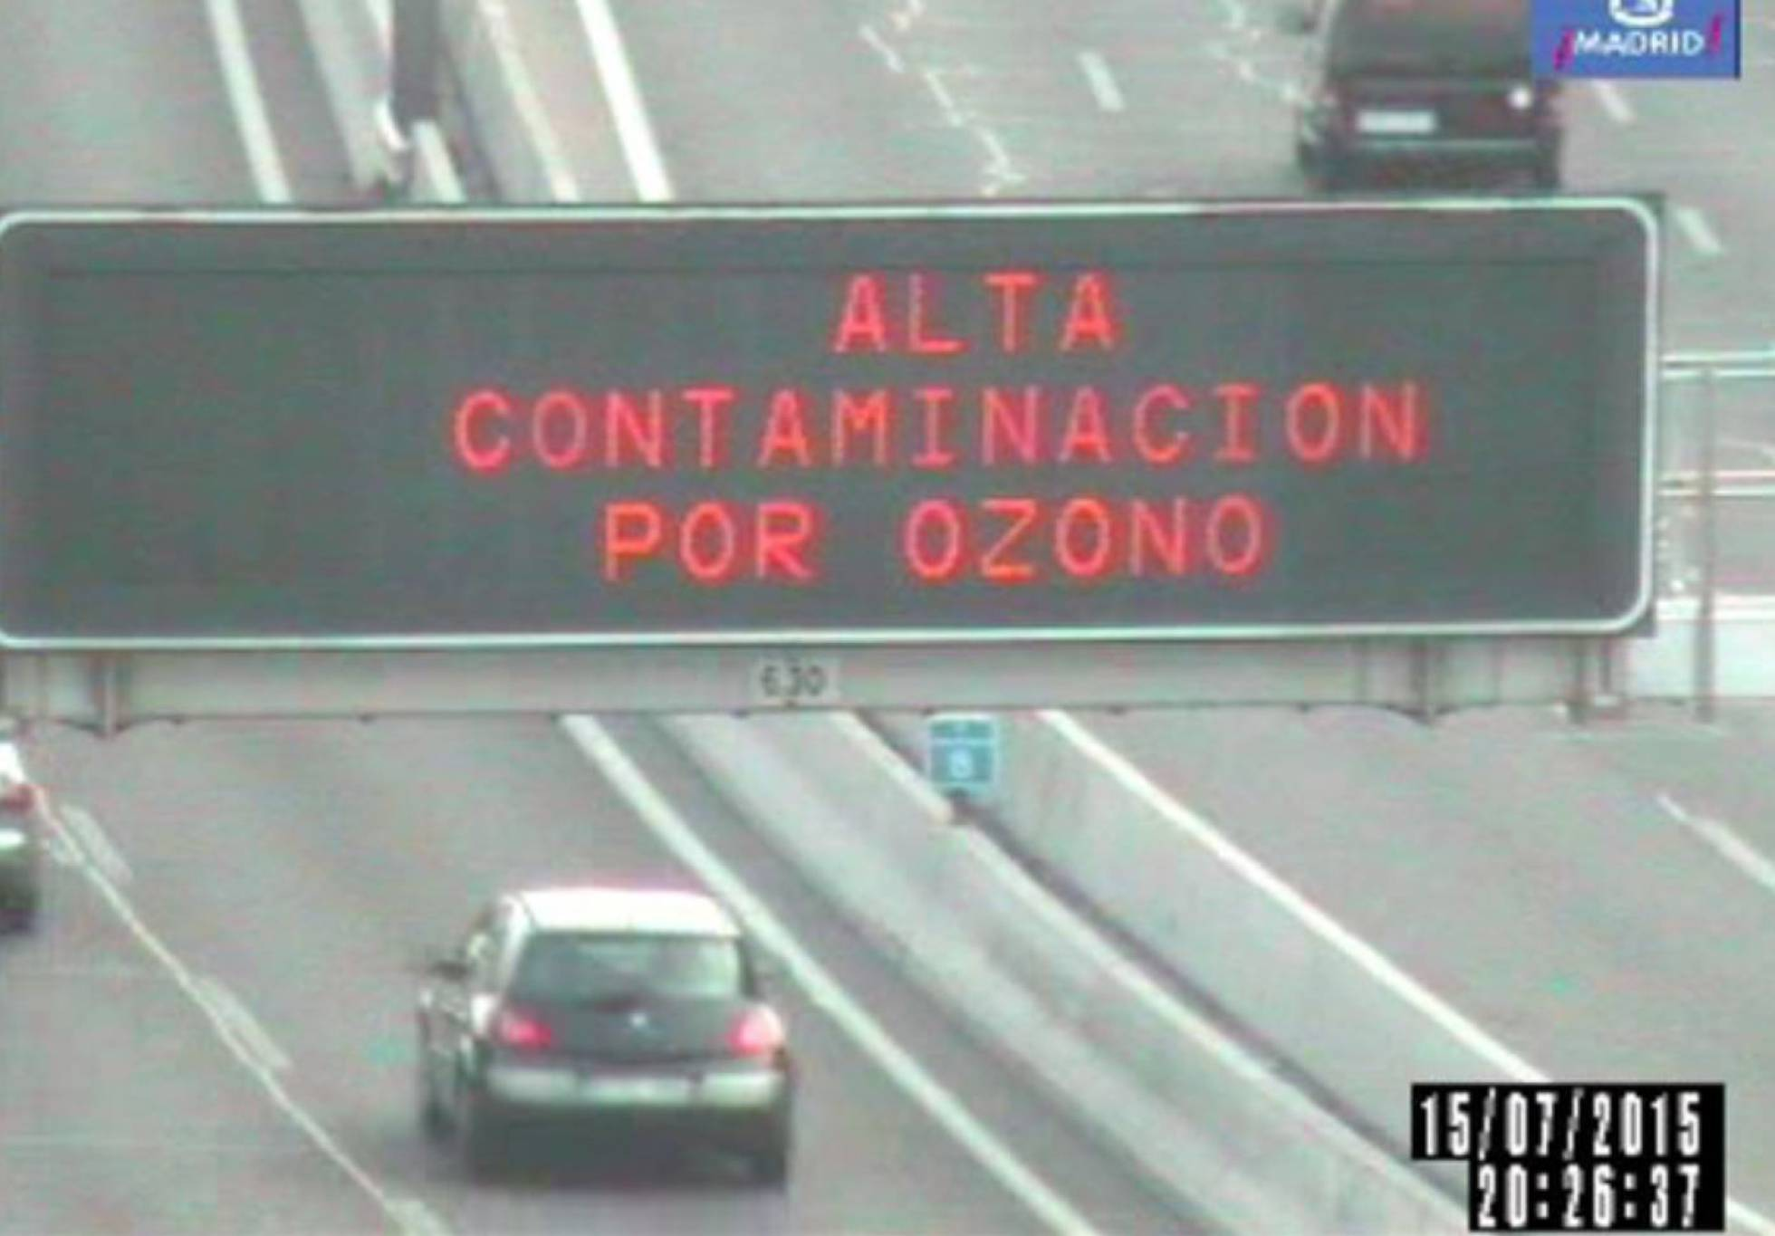
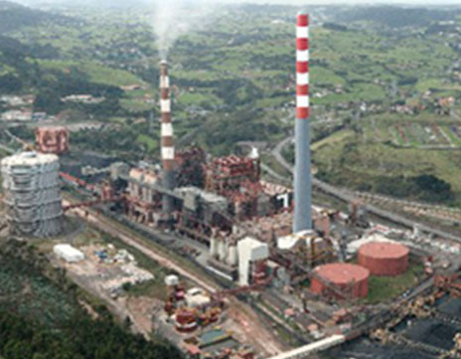
Major Sources
Industry
Traffic
Agriculture, Construction
Fossil Fuel Extraction
Commercial/Institutional
Homes/Buildings
Waste disposal
Power Plants

Slide 7

O₃ ground level
Carcinogens, neuronal & cardiovascular effects,
fetal development effects
CO
NO
NO₂
SO₂
Volatile Organic Compounds (VOC)
(e.g. benzene)
Polycyclic Aromatic
Hydrocarbons (PAH)
(e.g. benzo[a]pyrene)
Respiratory Irritants
Cardiovascular Disease
Particulate Matter
(PM10, PM2,5, PM1)
iron
mercury
lead
arsenic
cadmium
nickel
Neurologic and metabolic toxins,
carcinogens
All of the above!

Slide 8
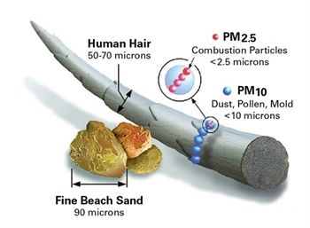
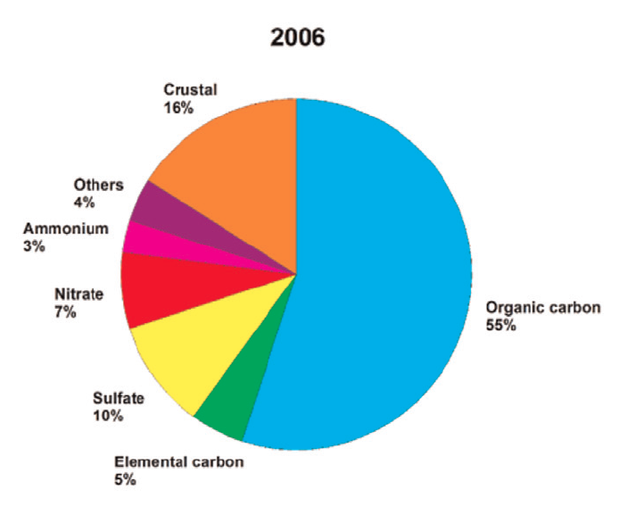
Particulate Matter: Toxic cocktails
Elemental carbon, gases and salts of sulfur, nitrogen, ammonia, metals, benzene, benzo[a]pyrene, toluene and other volatile organic compounds.
Sizes of <1 micrometers can enter the blood circulation via the alveoli, macrofages, or GI tract.
Evidence of PM entering the brain via the olfactory nerve.
Calderón-Garcidueñas et al., 2016

Slide 9
A killer stalking us
throughout life
Birth Defects
Premature Births
Pulmonary Development
Asthma
Brain Development
Learning and Memory
Childhood cancers
Stoke and Dementias
Pulmonary Diseases
Heart diseases
Cancer

Slide 10
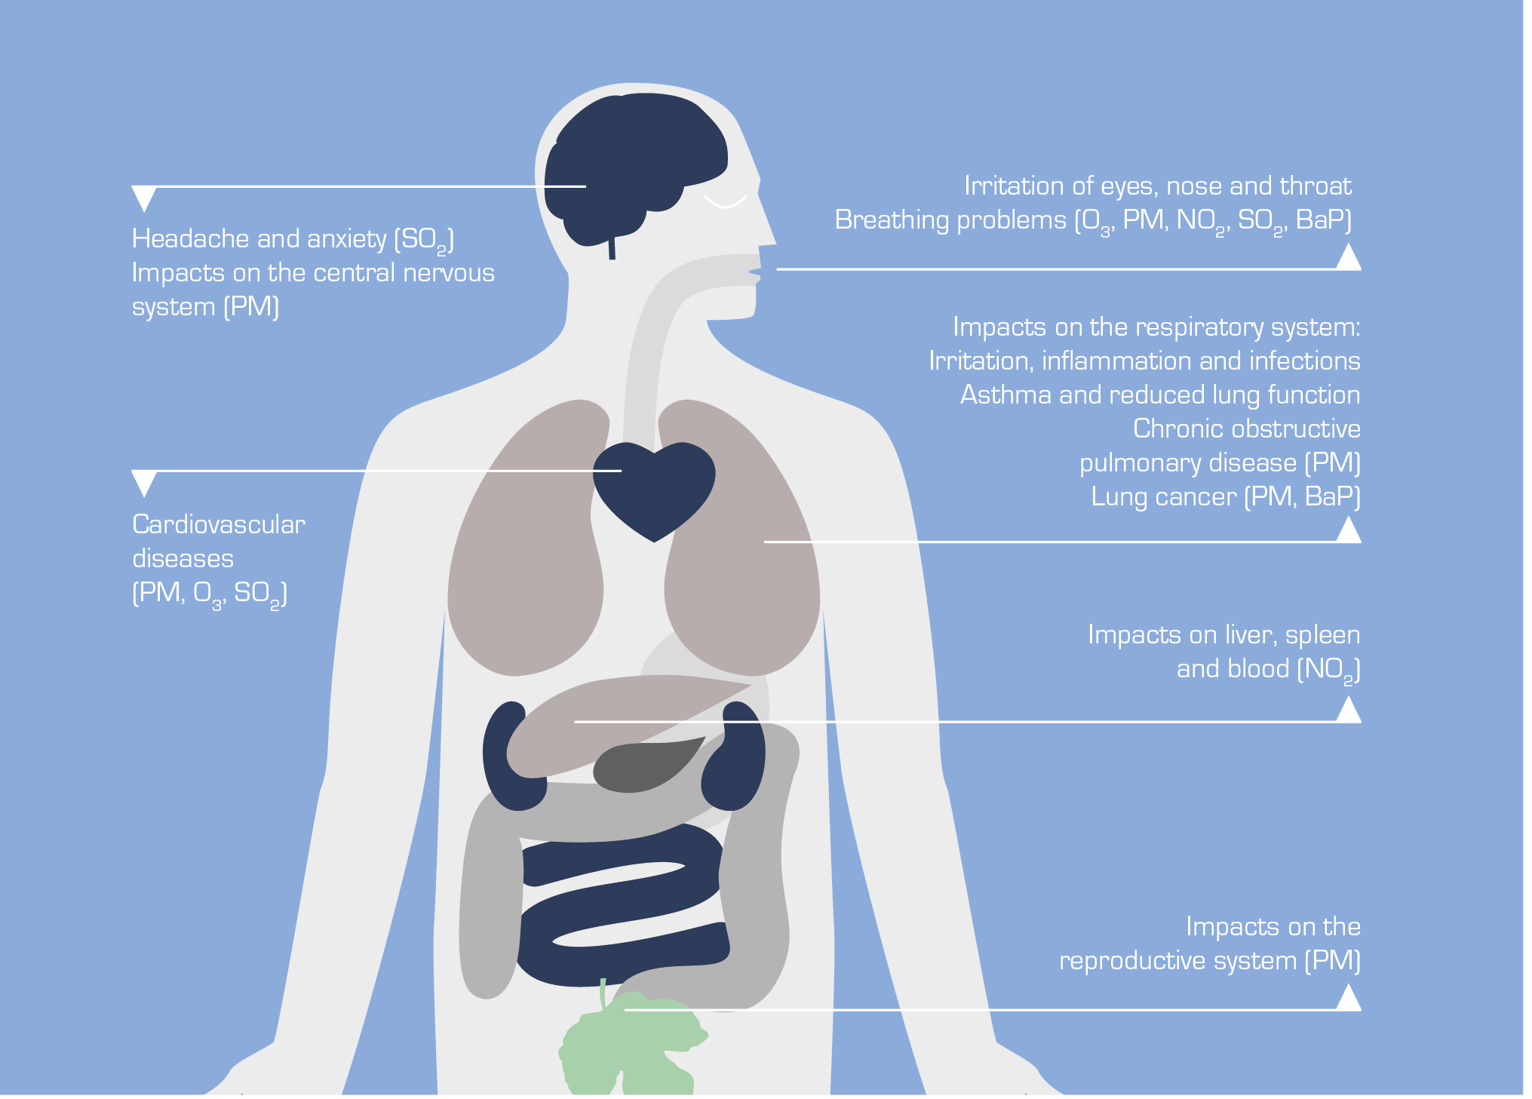
It’s not just the lungs
https://www.eea.europa.eu/signals/signals-2013/infographics/health-impacts-of-air-pollution/

Slide 11
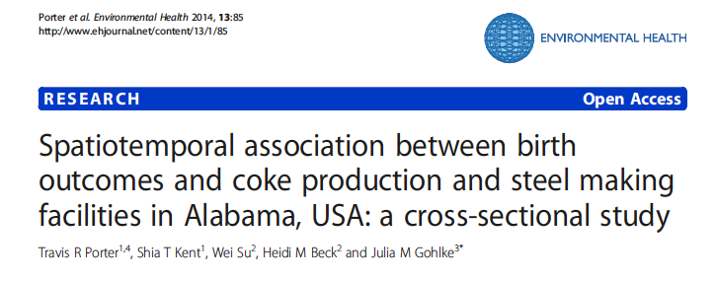
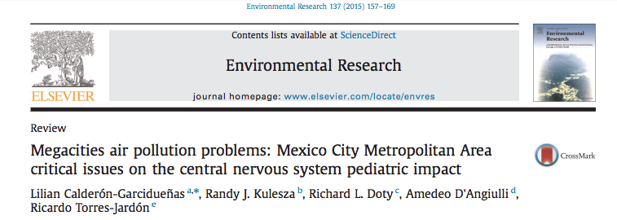

Birth defects
Premature births
Low birth weight
Lower lung capacity
Neurodevelopmental effects
Asthma, Diabetes II
White matter lesions, and markers of Alzheimer’s (brain plaques) found in children

Slide 12
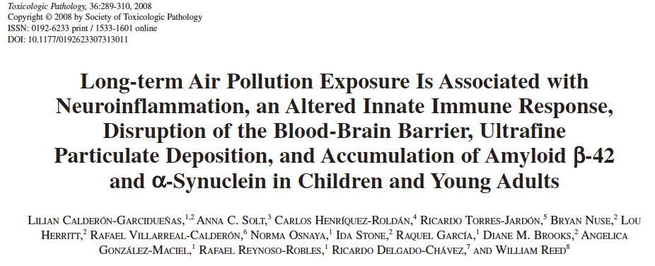
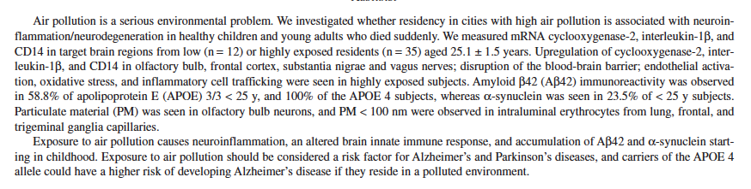

Slide 13
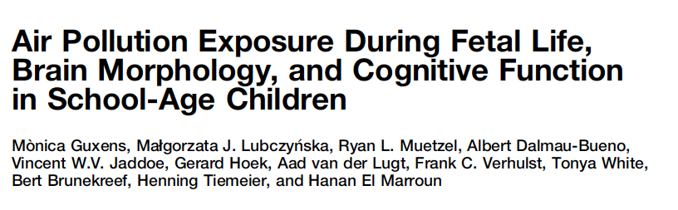
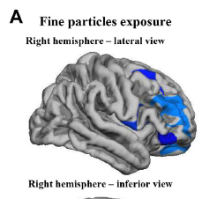
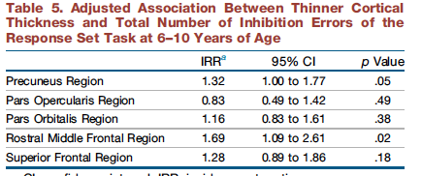

(6-10 y.o.)

Slide 14
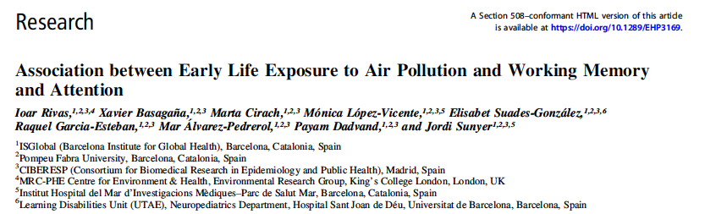
CONCLUSIONS: Early life exposure to PM2.5 was associated with a reduction in fundamental cognitive abilities at 7-10 y.o., including working memory and conflict attentional network.

Slide 15
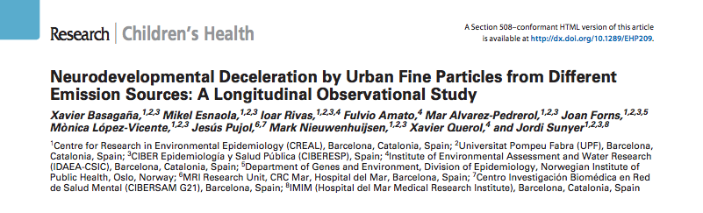
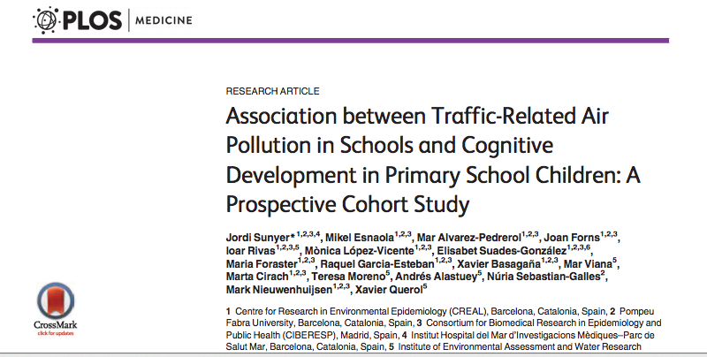
Neurodevelopment
2618 young students (~8.5 y) were tested for memory and attention 4 times over 1 year. PM2.5 was measured during twice over 1-week periods and analyzed for source. Traffic-related PM2.5 correlated inversely with preformance on the tests.
2715 young students (7-10 años) showed less improvements in cognitive tasks during 1 year if they were exposed to the highest levels of elemental carbon, NO₂, y PM2.5 in the study.
Notes:
We aimed to explore the role of PM sources in school air on cognitive development. Methods: A cohort of 2,618 schoolchildren (average age, 8.5 years) belonging to 39 schools in Barcelona (Spain) was followed up for a year. Children completed tests assessing working memory, superior working memory, and inattentiveness during four visits. Particulate matter ≤ 2.5 μm (PM2.5) was measured during two 1-week campaigns in each school, both outdoors and in the classroom. Source apportionment resulted in nine sources: mineral, organic/textile/chalk, traffic, secondary sulfate and organics, secondary nitrate, road dust, metallurgy, sea spray, and heavy oil combustion. Differences in cognitive growth trajectories were assessed with mixed models with age-by-source interaction terms. results: An interquartile range increase in traffic-related PM2.5 was associated with reduc tions in cognitive growth equivalent to 22% (95% CI: 2%, 42%) of the annual change in working memory, 30% (95% CI: 6%, 54%) of the annual change in superior working memory, and 11% (95% CI: 0%, 22%) of the annual change in the inattentiveness scale. None of the other PM2.5 sources was associated with adverse effects on cognitive development. conclusions: Traffic was the only source of fine particles associated with a reduction in cognitive development. Reducing air pollution from traffic at primary schools may result in beneficial effects on cognition.
We conducted a prospective study of children (n = 2,715, aged 7 to 10 y) from 39 schools in
Barcelona (Catalonia, Spain) exposed to high and low traffic-related air pollution, paired by
school socioeconomic index; children were tested four times (i.e., to assess the 12-mo developmental
trajectories) via computerized tests (n = 10,112). Chronic traffic air pollution
(elemental carbon [EC], nitrogen dioxide [NO2], and ultrafine particle number [UFP; 10–700
nm]) was measured twice during 1-wk campaigns both in the courtyard (outdoor) and inside
the classroom (indoor) simultaneously in each school pair. Cognitive development was assessed
with the n-back and the attentional network tests, in particular, working memory
(two-back detectability), superior working memory (three-back detectability), and inattentiveness
(hit reaction time standard error). Linear mixed effects models were adjusted for
age, sex, maternal education, socioeconomic status, and air pollution exposure at home.
Children from highly polluted schools had a smaller growth in cognitive development
than children from the paired lowly polluted schools, both in crude and adjusted models
(e.g., 7.4% [95% CI 5.6%–8.8%] versus 11.5%[95% CI 8.9%–12.5%] improvement in working
memory, p = 0.0024). Cogently, children attending schools with higher levels of EC,
NO2, and UFP both indoors and outdoors experienced substantially smaller growth in all
the cognitive measurements; for example, a change from the first to the fourth quartile in indoor
EC reduced the gain in working memory by 13.0% (95% CI 4.2%–23.1%). Residual
confounding for social class could not be discarded completely; however, the associations
remained in stratified analyses (e.g., for type of school or high-/low-polluted area) and after
additional adjustments (e.g., for commuting, educational quality, or smoking at home), contradicting
a potential residual confounding explanation.
Conclusions
Children attending schools with higher traffic-related air pollution had a smaller improvement
in cognitive development.

Slide 16
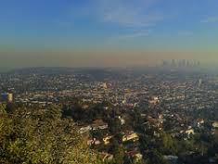
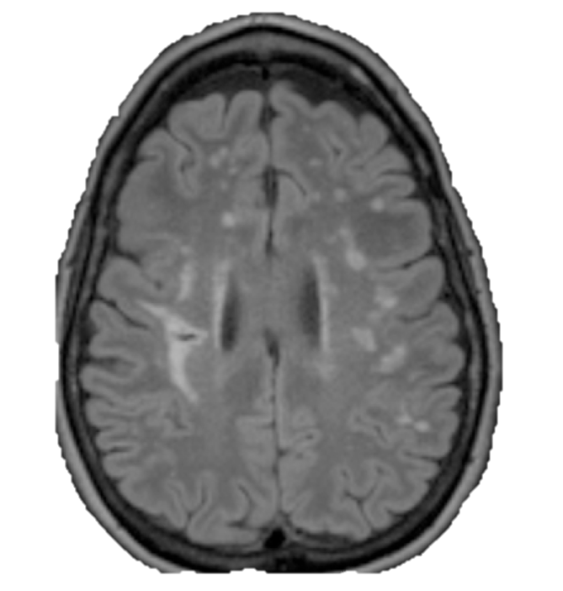
Stroke and Dementias

Slide 17
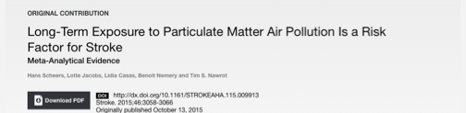
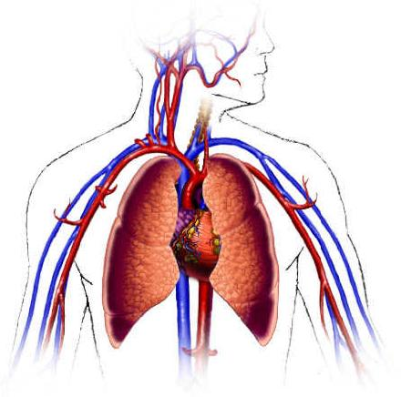
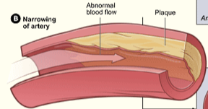
PM
Arterioesclerosis
Emboli
Embolism/
Thrombosis

Slide 18
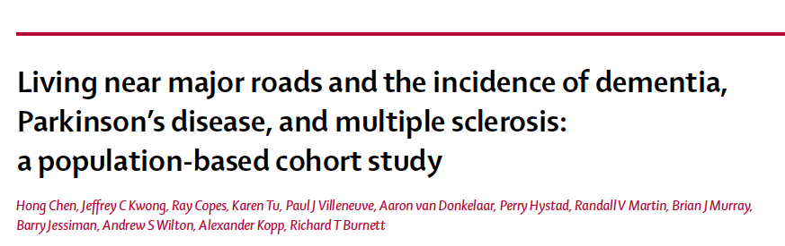
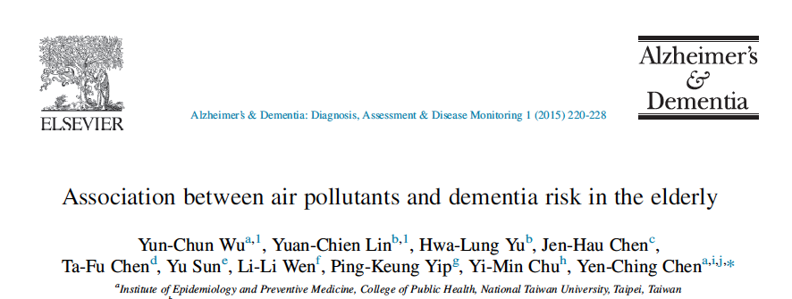
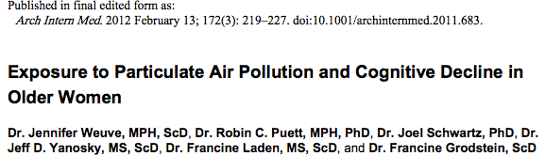
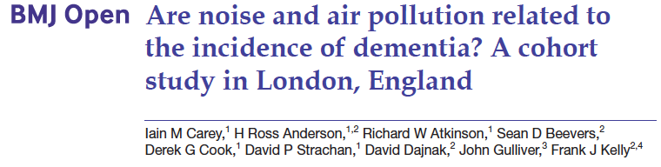
This study included 249 Alzheimer’s disease (AD) patients, 125 vascular dementia (VaD) patients, and 497 controls from three hospitals in northern Taiwan from 2007 to 2010. Data on PM10 and ozone were obtained from the Taiwan Environmental Protection Administration for 12 and 14 years, respectively. The highest tertile (3rd) of PM10 (49.23 µg/m³) or ozone (21.56 ppb) exposure was associated with increased AD risk. Similar findings were observed for VaD.
The study population comprised the Nurses’ Health Study Cognitive Cohort, which included 19,409 US women aged 70 to 81 years. Geographic information was used with to estimate recent (1 month) and long-term (7–14 years) exposures to PM2.5 and PM10, preceding base-line cognitive testing (1995–2001). Higher levels of long-term exposure to both PM10 and PM2.5 were associated with significantly faster cognitive decline. Two-year decline on a global score was 0.020 standard units worse per 10 μg/m³ increment in PM10 exposure and 0.018 units worse per 10 μg/m³ increment in PM2.5 exposure.
130,978 adults in London aged 50–79 years enrolled on 1 January 2005, with no recorded history of dementia. Average NO2, PM2.5 and O3 levels during 2004 were estimated. Traffic intensity, distance from major road and night-time noise levels were estimated at the subject postal codes and linked to clinical data. Diagnoses of dementia were noted during 2005–2013. There was a positive exposure response relationship between dementia and all measures of air pollution except O3. Adults living in areas with the highest fifth of NO2 concentration (>41.5 μg/m3) versus the lowest fifth (<31.9 μg/m3) were at a higher risk of dementia. Increases in dementia risk were also associated with higher PM2.5.
The incidences of dementia, Parkinson’s disease, and multiple sclerosis over a period of 11 years in Ontario were examined as a function of residential proximity to major roads (in 2-4 million adults in two age groups, who were initially disease-free). Distances of 50 to 300 m from the roads were examined. The further from major roads, the less the risk (hazard ratio) of dementia. The associations were stronger among urban residents, especially those who lived in major cities and who never moved.
Notes:
Summary
Background Emerging evidence suggests that living near major roads might adversely aff ect cognition. However, little
is known about its relationship with the incidence of dementia, Parkinson’s disease, and multiple sclerosis. We aimed
to investigate the association between residential proximity to major roadways and the incidence of these three
neurological diseases in Ontario, Canada.
Methods In this population-based cohort study, we assembled two population-based cohorts including all adults
aged 20–50 years (about 4.4 million; multiple sclerosis cohort) and all adults aged 55–85 years (about 2.2 million;
dementia or Parkinson’s disease cohort) who resided in Ontario, Canada on April 1, 2001. Eligible patients were free
of these neurological diseases, Ontario residents for 5 years or longer, and Canadian-born. We ascertained the
individual’s proximity to major roadways based on their residential postal-code address in 1996, 5 years before
cohort inception. Incident diagnoses of dementia, Parkinson’s disease, and multiple sclerosis were ascertained
from provincial health administrative databases with validated algorithms. We assessed the associations between
traffi c proximity and incident dementia, Parkinson’s disease, and multiple sclerosis using Cox proportional hazards
models, adjusting for individual and contextual factors such as diabetes, brain injury, and neighbourhood income.
We did various sensitivity analyses, such as adjusting for access to neurologists and exposure to selected air
pollutants, and restricting to never movers and urban dwellers.
Findings Between 2001, and 2012, we identifi ed 243 611 incident cases of dementia, 31 577 cases of Parkinson’s disease,
and 9247 cases of multiple sclerosis. The adjusted hazard ratio (HR) of incident dementia was 1.07 for people living
less than 50 m from a major traffi c road (95% CI 1.06–1.08), 1.04 (1.02–1.05) for 50–100 m, 1.02 (1.01–1.03) for
101–200 m, and 1.00 (0.99–1.01) for 201–300 m versus further than 300 m (p for trend=0.0349). The associations
were robust to sensitivity analyses and seemed stronger among urban residents, especially those who lived in major
cities (HR 1.12, 95% CI 1.10–1.14 for people living <50 m from a major traffi c road), and who never moved (1.12,
1.10–1.14 for people living <50 m from a major traffi c road). No association was found with Parkinson’s disease or
multiple sclerosis.
Interpretation In this large population-based cohort, living close to heavy traffi c was associated with a higher incidence
of dementia, but not with Parkinson’s disease or multiple sclerosis.
Background: The aging rate in Taiwan is the second highest in the world. As the population ages quickly, the prevalence of dementia increases rapidly. There are some studies that have explored the association between air pollution and cognitive decline, but the association between air pollution and dementia has not been directly evaluated.
Methods: This was a case-control study comprising 249 Alzheimer’s disease (AD) patients, 125 vascular dementia (VaD) patients, and 497 controls from three teaching hospitals in northern Taiwan from 2007 to 2010. Data of particulate matter ,10 mm in diameter (PM10) and ozone were obtained from the Taiwan Environmental Protection Administration for 12 and 14 years, respectively. Blood samples were collected to determine the apolipoprotein E (APOE) 34 haplotype. Bayesian maximum
entropy was used to estimate the individual exposure level of air pollutants, which was then tertiled for analysis. Conditional logistic regression models were used to estimate adjusted odds ratios (AORs) and 95% confidence intervals between the association of PM10 and ozone exposure with AD and VaD risk.
Results: The highest tertile of PM10 (_49.23 mg/m3) or ozone (_21.56 ppb) exposure was associated with increased AD risk (highest vs. lowest tertile of PM10: AOR 5 4.17; highest vs. lowest tertile of ozone: AOR 5 2.00). Similar finding was observed for VaD. The association with AD and VaD risk remained for the highest tertile PM10 exposure after stratification by APOE 34 status and gender.
Conclusions: Long-term exposure to the highest tertile of PM10 or ozone was significantly associated with an increased risk of AD and VaD.
Abstract
Objective To investigate whether the incidence of
dementia is related to residential levels of air and noise
pollution in London.
Design Retrospective cohort study using primary care
data.
Setting 75 Greater London practices.
Participants 130 978 adults aged 50–79 years registered
with their general practices on 1 January 2005, with no
recorded history of dementia or care home residence.
Primary and secondary outcome measures A first
recorded diagnosis of dementia and, where specified,
subgroups of Alzheimer’s disease and vascular dementia
during 2005–2013. The average annual concentrations
during 2004 of nitrogen dioxide (NO2), particulate matter
with a median aerodynamic diameter ≤2.5 μm (PM2.5) and
ozone (O3) were estimated at 20Å~20 m resolution from
dispersion models. Traffic intensity, distance from major
road and night-time noise levels (Lnight) were estimated
at the postcode level. All exposure measures were linked
anonymously to clinical data via residential postcode. HRs
from Cox models were adjusted for age, sex, ethnicity,
smoking and body mass index, with further adjustments
explored for area deprivation and comorbidity.
Results 2181 subjects (1.7%) received an incident
diagnosis of dementia (39% mentioning Alzheimer’s
disease, 29% vascular dementia). There was a positive
exposure response relationship between dementia and all
measures of air pollution except O3, which was not readily
explained by further adjustment. Adults living in areas
with the highest fifth of NO2 concentration (>41.5 μg/m3)
versus the lowest fifth (<31.9 μg/m3) were at a higher risk
of dementia (HR=1.40, 95% CI 1.12 to 1.74). Increases
in dementia risk were also observed with PM2.5, PM2.5
specifically from primary traffic sources only and Lnight,
but only NO2 and PM2.5 remained statistically significant in
multipollutant models. Associations were more consistent
for Alzheimer’s disease than vascular dementia.
Conclusions We have found evidence of a positive
association between residential levels of air pollution
across London and being diagnosed with dementia, which
is unexplained by known confounding factors.
Abstract
Background—Chronic exposure to particulate air pollution may accelerate cognitive decline in older adults, although data on this association are limited. Our objective was to examine long-term exposure to particulate matter (PM) air pollution, both coarse ([PM 2.5–10 μm in diameter [PM2.5-10]) and fine (PM <2.5 μm in diameter [PM2.5]), in relation to cognitive decline.
Methods—The study population comprised the Nurses’ Health Study Cognitive Cohort, which included 19 409 US women aged 70 to 81 years. We used geographic information system–based spatiotemporal smoothing models to estimate recent (1 month) and long-term (7–14 years) exposures to PM2.5-10, and PM2.5 preceding base-line cognitive testing (1995–2001) of participants residing in the contiguous United States. We used generalized estimating equation regression to estimate differences in the rate of cognitive decline across levels of PM2.5-10 and PM2.5 exposures. The main outcome measure was cognition, via validated telephone assessments, administered 3 times at approximately 2-year intervals, including tests of general cognition, verbal memory, category fluency, working memory, and attention.
Results—Higher levels of long-term exposure to both PM2.5-10 and PM2.5 were associated with significantly faster cognitive decline. Two-year decline on a global score was 0.020 (95% CI, −0.032 to −0.008) standard units worse per 10 μg/m3 increment in PM2.5-10 exposure and 0.018 (95% CI, −0.035 to −0.002) units worse per 10 μg/m3 increment in PM2.5 exposure.

Slide 19
How?

Slide 20
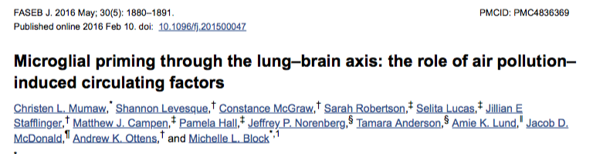
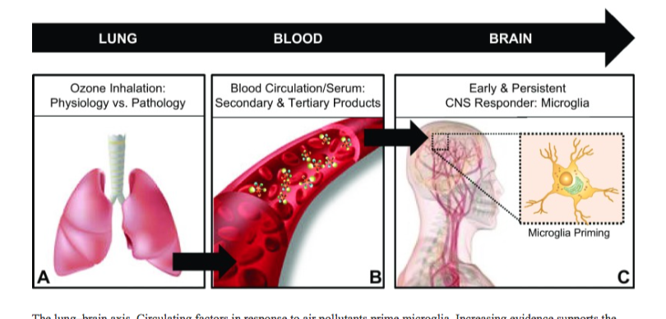

Slide 21
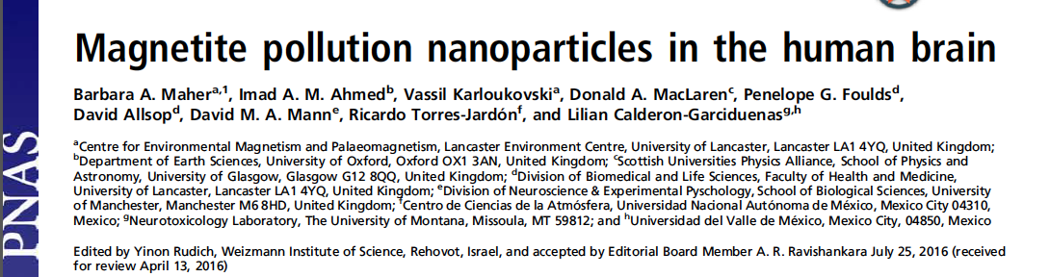
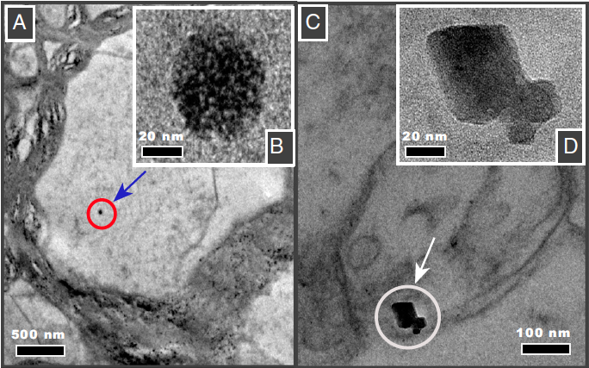
Particles of iron oxide (~0.02-0.2μm) and other metals found post mortem in brain samples.
The particles do not appear to be of biologic origin (amorphous rather than crystalline).
Possible entrance to brain via olfactory nerve.
The iron could facilitate the generation of reactive oxygen species, cause inflammation, and thus contribute to Alzheimer’s disease.
Fig. 1. Transmission electron micrographs of brain thin sections, identifying two distinct types of magnetite morphologies within frontal cells: (A and F) rounded particles (A shown at higher magnification in B); and (C) angular, euhedral particles, which we attribute to endogenous formation (particles from C shown at higher magnification in D).

Slide 22
Possible Paths to Neurodegeneration
PM
Oxidative Stress
(free radicals)
Inflammation
(systemic or cerebral)
Protein & DNA damage
( amyloid-beta, tau, synuclien)
cytokines
vasoconstriction
Neurodegeneration
(Apoptosis)
Developmental
delays
Parkinson’s
Alzheimer’s

Slide 23
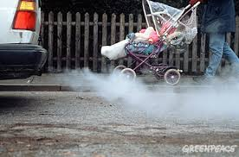
How much is healthy?

Slide 24
The “invisible killer”
The World Health Organization has concluded that Air Pollution is a cause of more than
7 million early deaths each year.

Slide 25
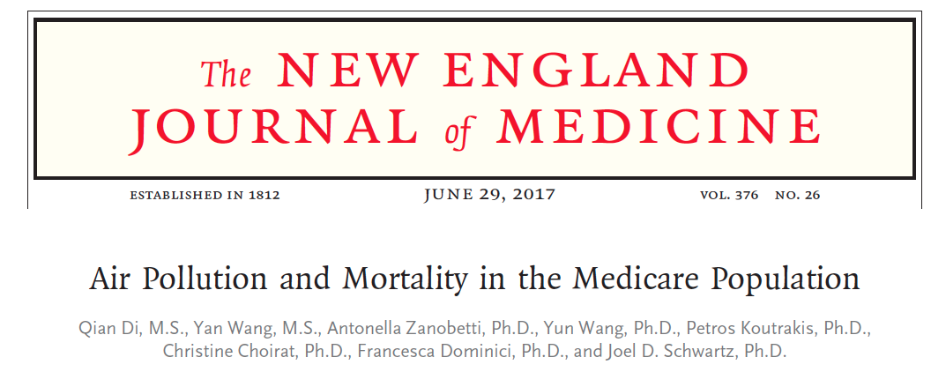
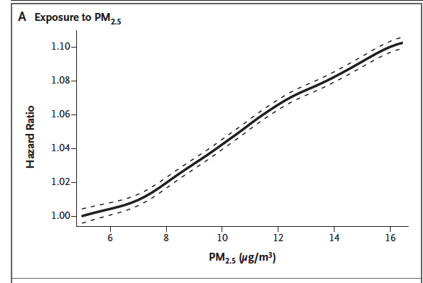
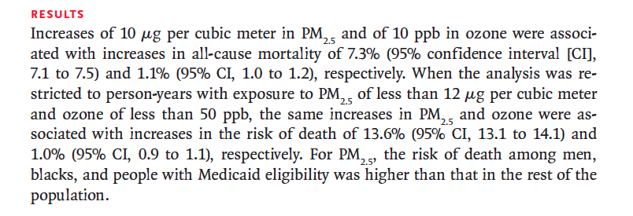
All Medicare beneficiaries (60,925,443 persons)min the continental United States from the years 2000 through 2012,

Slide 26




Slide 27



Each short-term increase of 10 μg/m3 in PM2.5 (adjusted by ozone) and 10 parts per billion (10−9) in warm-season ozone (adjusted by PM2.5) were statistically significantly associated with a relative increase of 1.05%(95%CI, 0.95%-1.15%) and 0.51%(95%CI, 0.41%-0.61%) in dailymortality rate.

Slide 28



Slide 29

What are our air quality standards
and how are they monitored?

Slide 30


Science versus Politics
The scientific evidence shows that there is no threshold below which PM exposure does not have harmful effects on health.
We can’t ask everyone to stop driving tomorrow. But we can establish regulations for reducing emissions.

Slide 31


Guidel
ines
PM2.5 25 μg/m3 de media en 24h
10 μg/m3 de media annual
SO2 500 μg/m3 de media en 10 min
20 μg/m3 media en 24h
NO2 200 μg/m3 de media en 1h
40 μg/m3 de media annual
PM10 50 μg/m3 de media en 24h
20 μg/m3 de media annual
CO 15 minutes – 100 mg/m3.
1 hour – 35 mg/ m3.
8 hours – 10 mg/ m3.
24 hours – 7 mg/m3
Benzene 0
O3 100 μg/m3 de media en 8h
Polycyclic 0
Aromatic
Hydrocarbons
WHO
European Union

Slide 32

http://aqicn.org/map/europe/

Slide 33


C = C_{low} + (C_{high}-C_{low})(I-I_{low})/(I_{igh}-I_{low})

Slide 34



Averaged Annual PM10 in my Neighborhood in Gijon
Bad
EU
WHO
WHO: There is no safe threshold!
GOOD

Slide 35



Thank you for your attention!

