Slide 1
3h = H
Gymnasium of Platykampos

Slide 2
C₃
Helping is Healthy
Volunteering organizations

Slide 3
“The smile of the child”
"The Smile of the Child" was created in 1995 by 10-year-old Andreas Yannopoulos, who, shortly before leaving from life, expressed in his diary his wish to found an organization that will ensure for all children what he had so generously enjoyed: love, affection, care and respect.

Slide 4
“The smile of the child”
The dream of 10-year-old Andreas became reality and today the Organization "The Smile of the Child", recognized internationally, with a Vision: the Smile of every child, implements nationwide, 365 days a year and 24 hours a day, effective and direct actions for preventing and addressing particular phenomena that threaten children.

Slide 5
“The smile of the child”
In the course of 23 years of action "The Smile of the Child" has supported more than 1.480.000 children and their families. Children victims of any form of violence, missing children, children with health problems, children living in poverty or threatened by poverty, have found a solution.

Slide 6
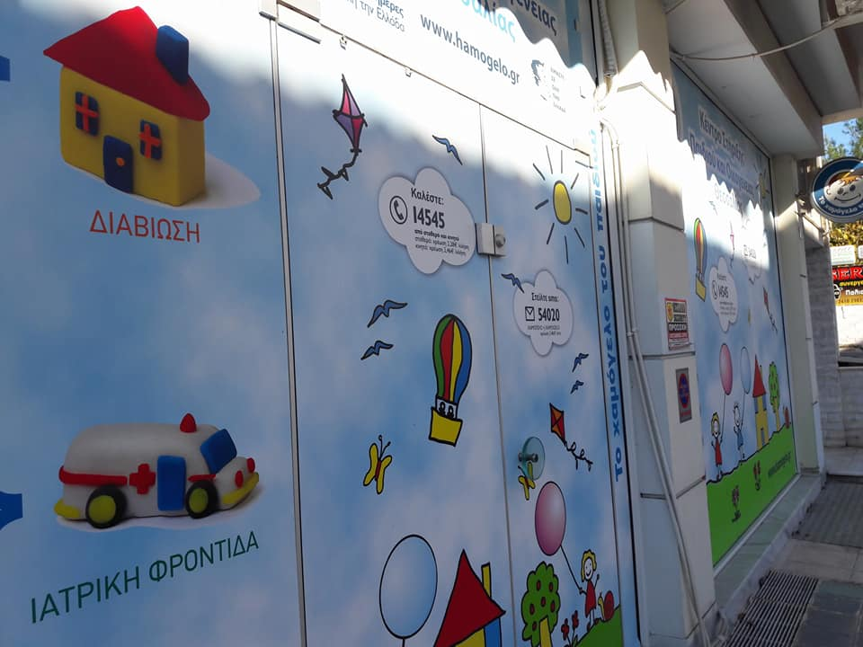
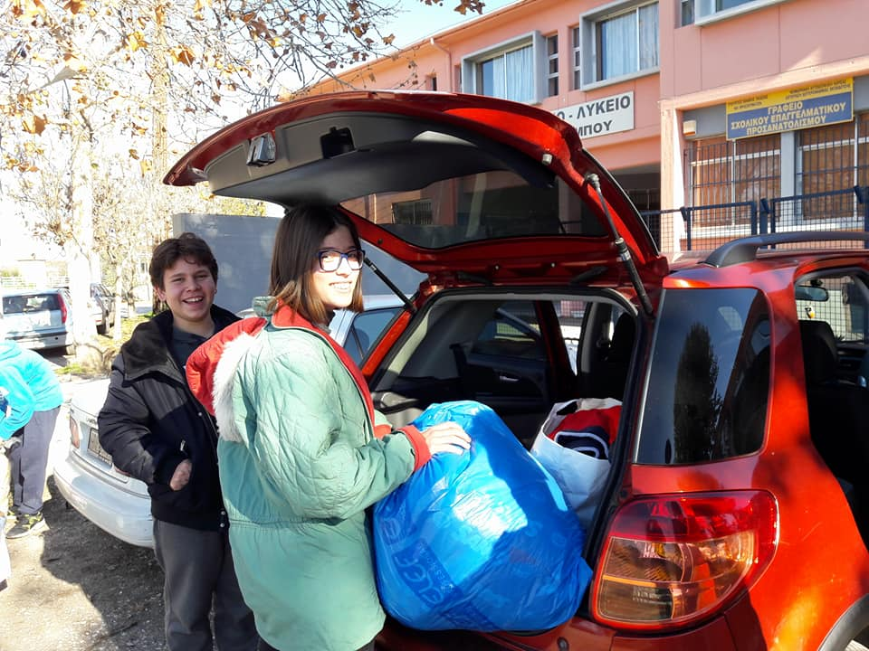
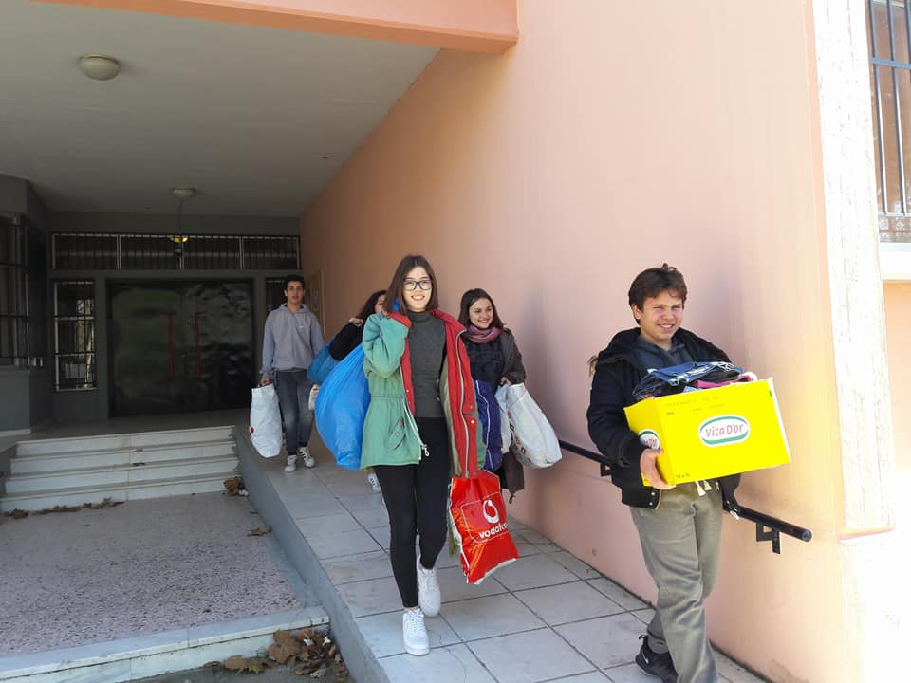
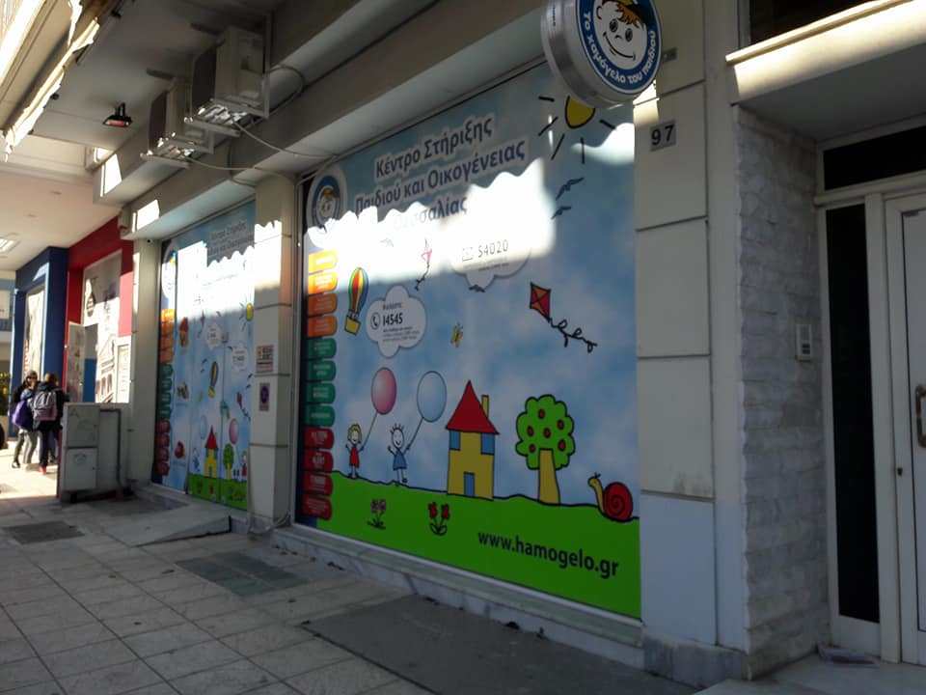
Every year, our school collects clothes, toys, notebooks, pencils and other school items and donates them to “the smile of the childe”

Slide 7
The poor fund of the church of our village
The church of our village has undertaken to support families and people who live there, and are on the risk of poverty or are threatened by it.

Slide 8
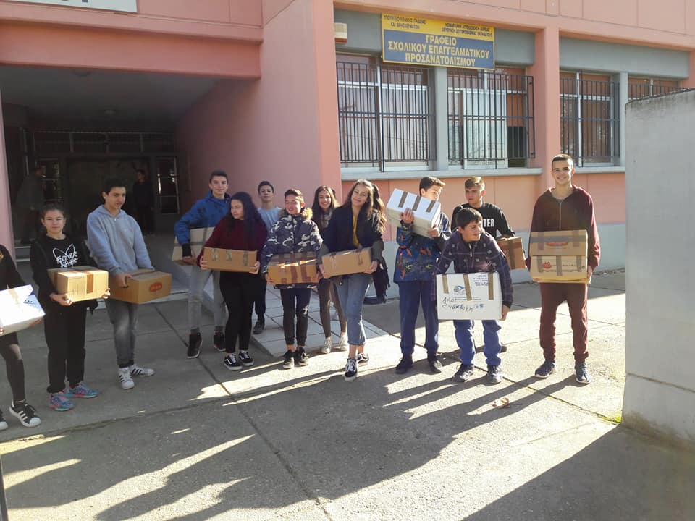
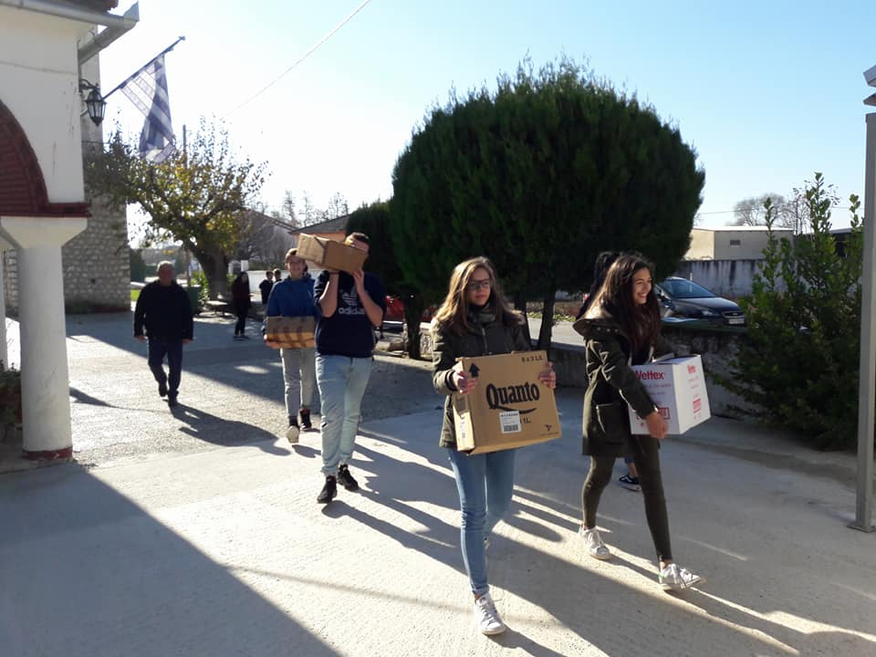
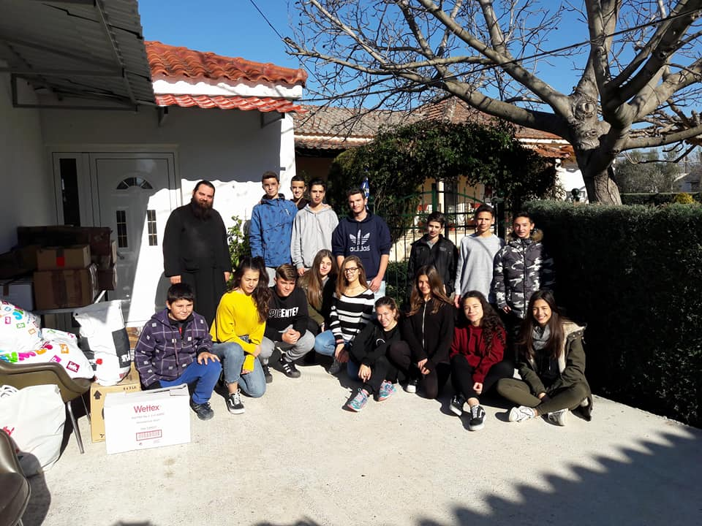
Our school, sensitive to social issues, every year collects food and clothes and gives them to the church to help people in need.

Slide 9
Many other voluntary organizations are active in our region and in Greece. May one day eliminate all the need for the existence of these organizations.

Slide 10
Thank you for your attention

